Slide 1




Welcome to DARES 2025
Workshop on AI-driven Data Engineering and Reusability for Earth and Space Sciences
Iraklis Klampanos, Antonis Troumpoukis, Manolis Koubarakis (Organisers)

Slide 2
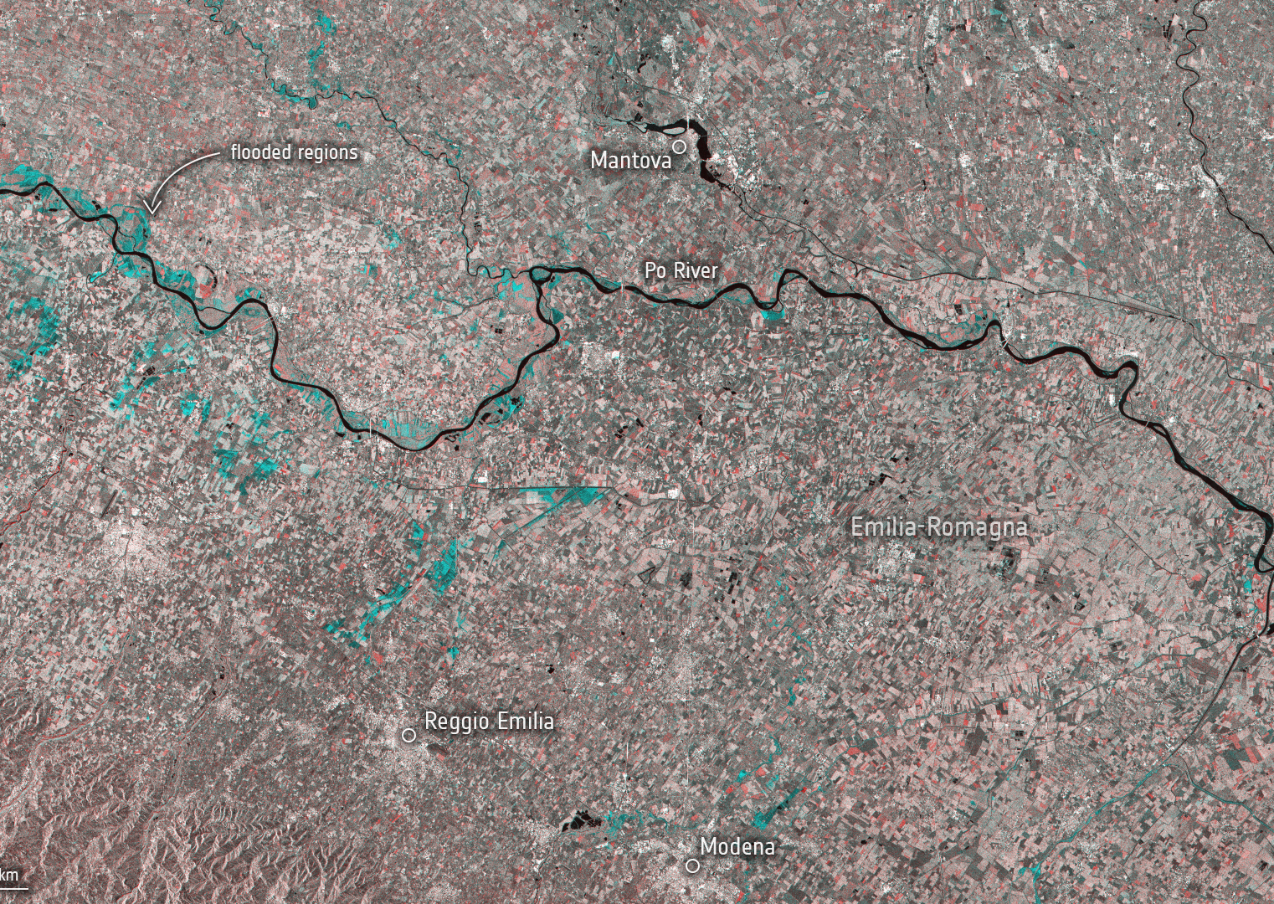
Earth, Space & Environmental Data
Copernicus EO Data
ERA5 Reanalysis
CMIP6 Climate Projections
Text – natural-language
In-situ, networks, etc.
Application or domain-specific
Biodiversity
Social
Many more!
Source: ESA

Slide 3
Earth, Space & Environmental Data
High data volume
High heterogeneity
High-impact applications
Research and innovation
Generally, publicly funded
Leverage AI to facilitate reusability & openness
Accelerate synthesis & adoption
Enable scientific breakthroughs
Enable novel downstream applications

Slide 4
Intelligent Data Engineering for EO & Space
(Horizontals)
Confidence in results
Trustworthiness
AI-aware data provenance
Open Science best practices
FAIR
Novel, reusable datasets & methods
Learning to fuse
Foundation models
Knowledge management
Agentic and synergistic AI

Slide 5
DARES Workshop
EO & Space closer to the European core AI community
Original workshop at IGARSS 2024
14 submissions
Each reviewed by at least 2 reviewers
11 papers accepted for presentation
2 keynote presentations
Yanni, Saso, thank you!

Slide 6
DARES'25 AI & Data Engineering Areas
AI Models & Learning
Foundation Models (Self-Supervision) , Trustworthy AI , Deep Learning (GRU, Downscaling) , Explainable AI (XAI) , Domain Adaptation , Semi-Supervised & Multi-label Classification.
Knowledge Systems
Knowledge Graphs (KGs) (LLM-Driven Construction) , Semantic Retrieval (KG-Enhanced RAG) , Agentic Systems (Digital Twins of the Earth).
Data Preparation & Analysis
Time-Series Analysis (Clustering/Forecasting) , Data Fusion (Integration/Downscaling) , Synthetic Data Quality Assessment , Robust Preprocessing.

Slide 7
Next Steps
Submit DARES proceedings to CEUR
Communication with Journals – Special Issue
Environmental Modelling and Software (ELSEVIER)
Computers & Geosciences (ELSEVIER)
Earth Science Informatics (Springer Nature)
All presentations and papers will also be made available on the DARES webpage:
http://dares25.github.io/

Slide 8
Thank you!

